Slide 1
Introduction to Exome Analysis in Galaxy
Carol Bult, Ph.D.
Professor
Deputy Director, JAX Cancer Center
Short Course Bioinformatics Workshops
2014
Disclaimer…I am on the Galaxy Advisory Board

Slide 2
You can do these exercises in Galaxy without an account
But without an account you can’t save your work
Many of the data files are LARGE and will take awhile to upload
Available from a public DropBox account
https://www.dropbox.com/sh/seqishl631f363x/AADoBskzYjPt_iJI21dxJqV8a

Slide 3
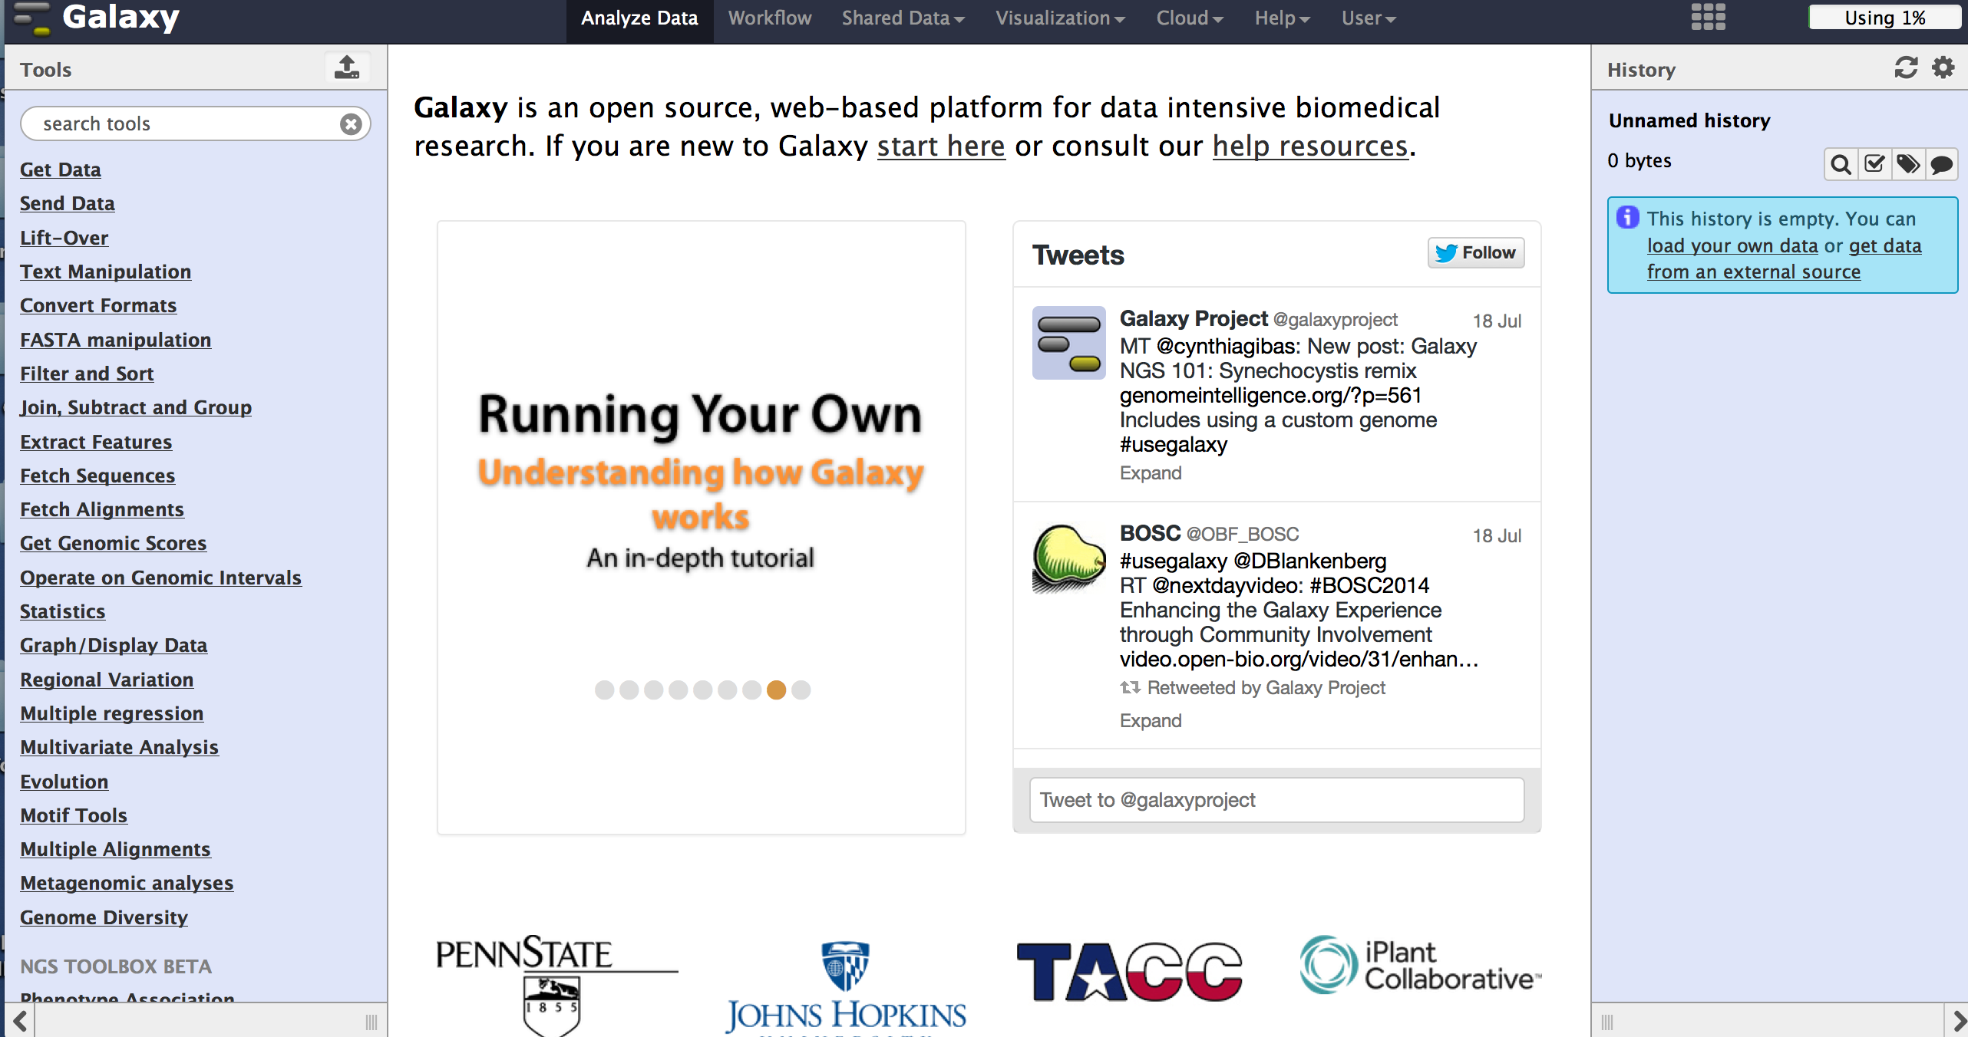
Galaxy
List of Tools
Dialog panel
Analysis history
https://usegalaxy.org/

Slide 4
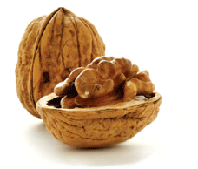
Galaxy in a Nutshell
Analyze
Build reusable analysis workflows for many types of data analysis needs
Interactive analysis
Reproducible analysis pipelines
Many analysis tools available … ready to use!
Visualize
Send analysis results to standard genome browsers
Publish and Share
Saved histories record the details of your analysis steps
Open access to data and analysis results to colleagues
Package analysis results for publication

Slide 5
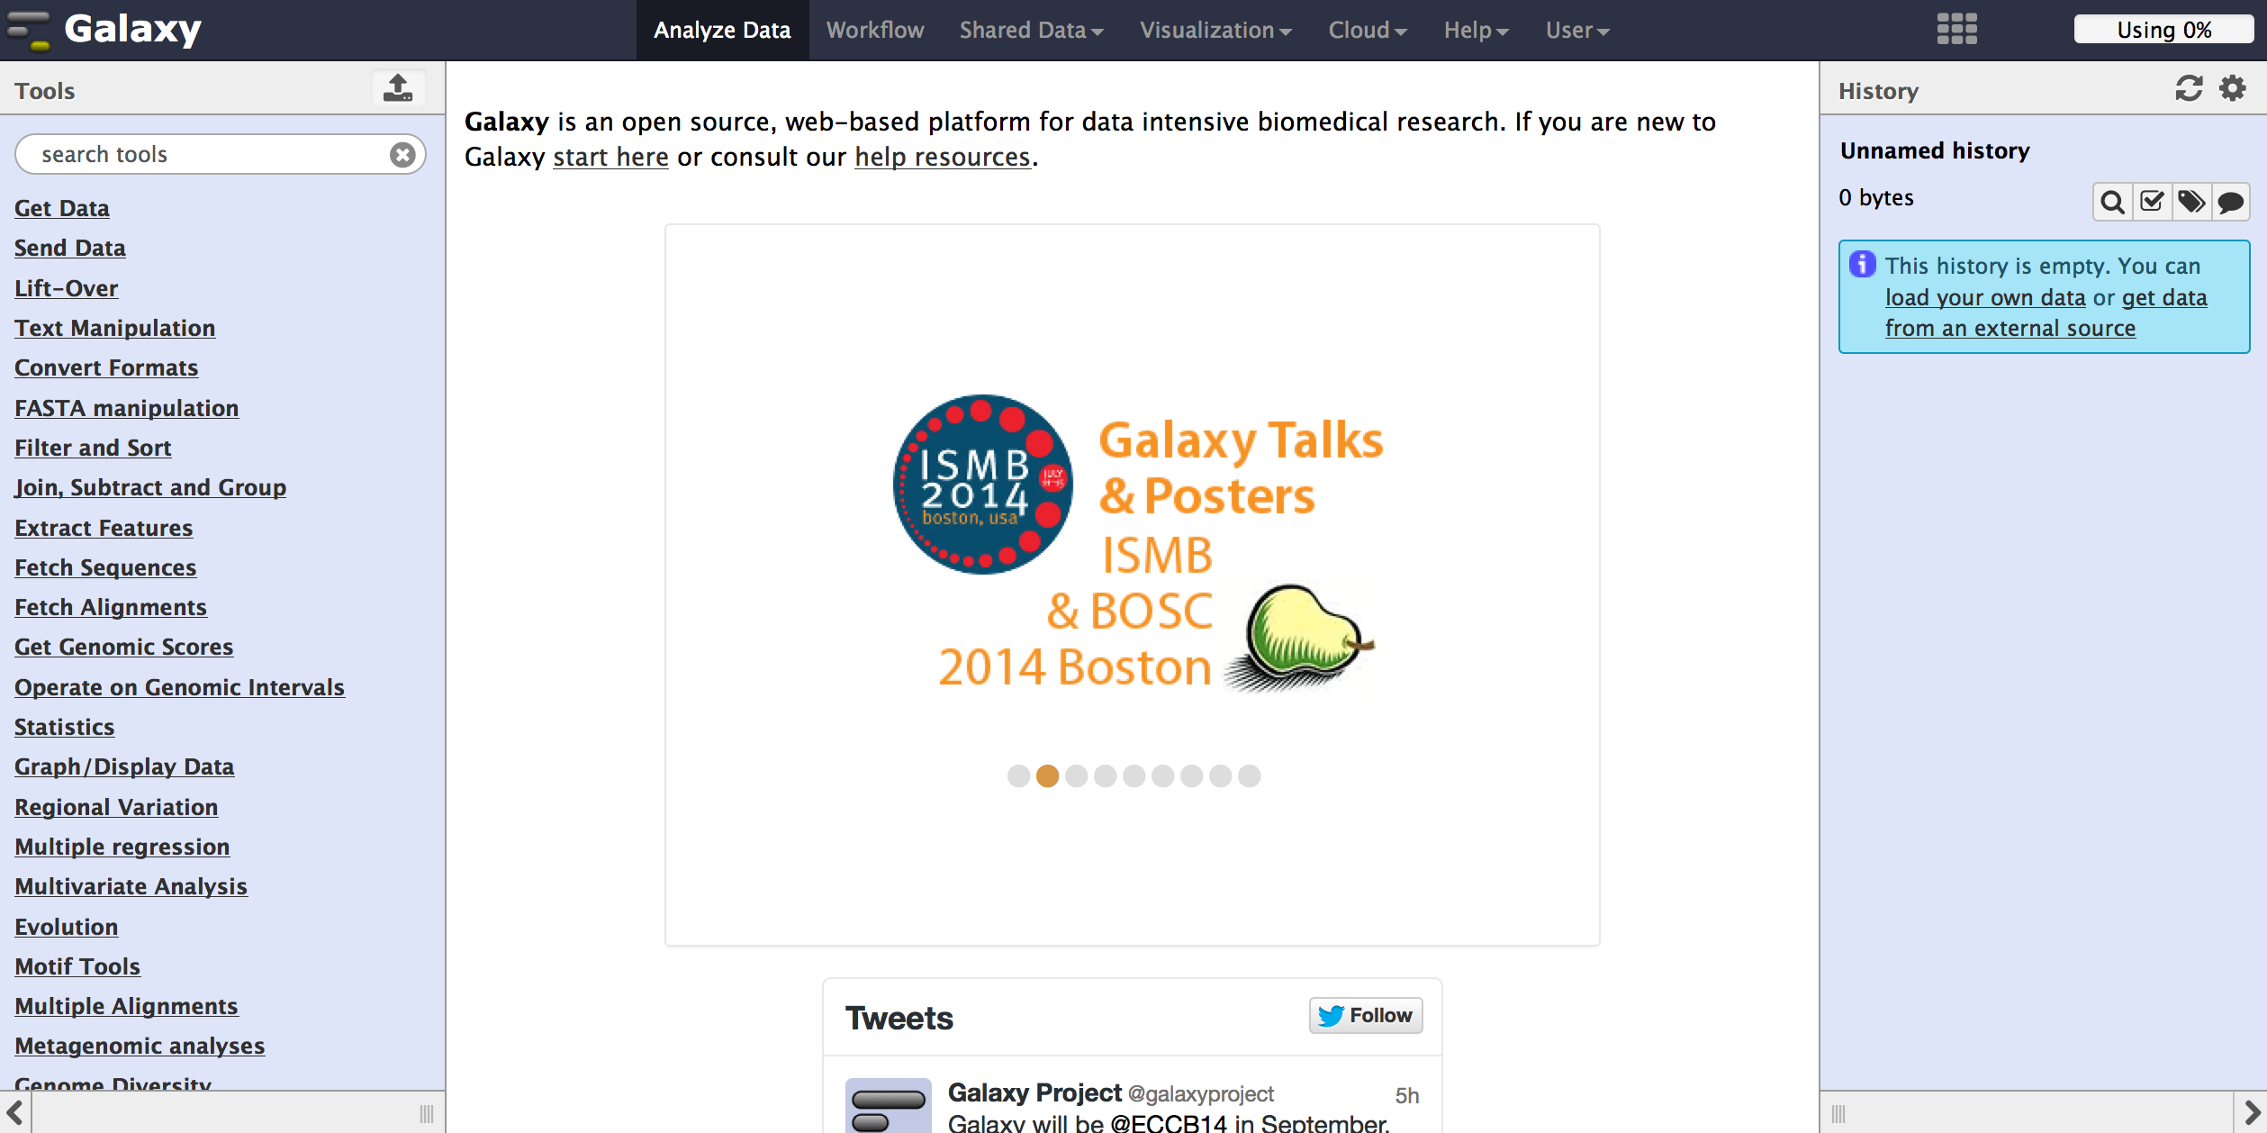
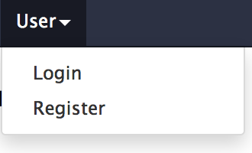
1. Click
You can use Galaxy without registering but you can’t save your data analysis workflows, etc.

Slide 6
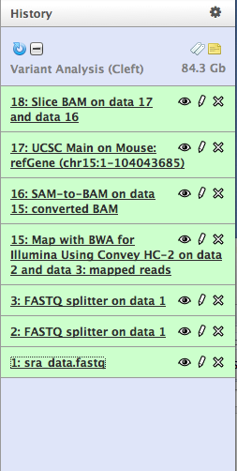
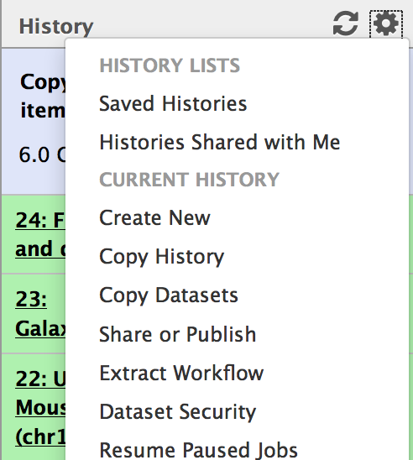
Example of what the history of analysis would look like in Galaxy.
Green color means the analysis completed successfully.
Once you have a history that works you can share it or turn it into a workflow
Click on the cog to see History options

Slide 7
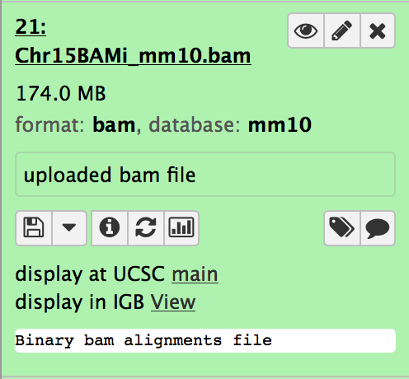
Visualization
Galaxy results include links to visualization tools
UCSC Genome Browser, IGV (external)
Trackster (Galaxy’s internal viz tool)
Click here first
View in Trackster
View @ UCSC

Slide 8
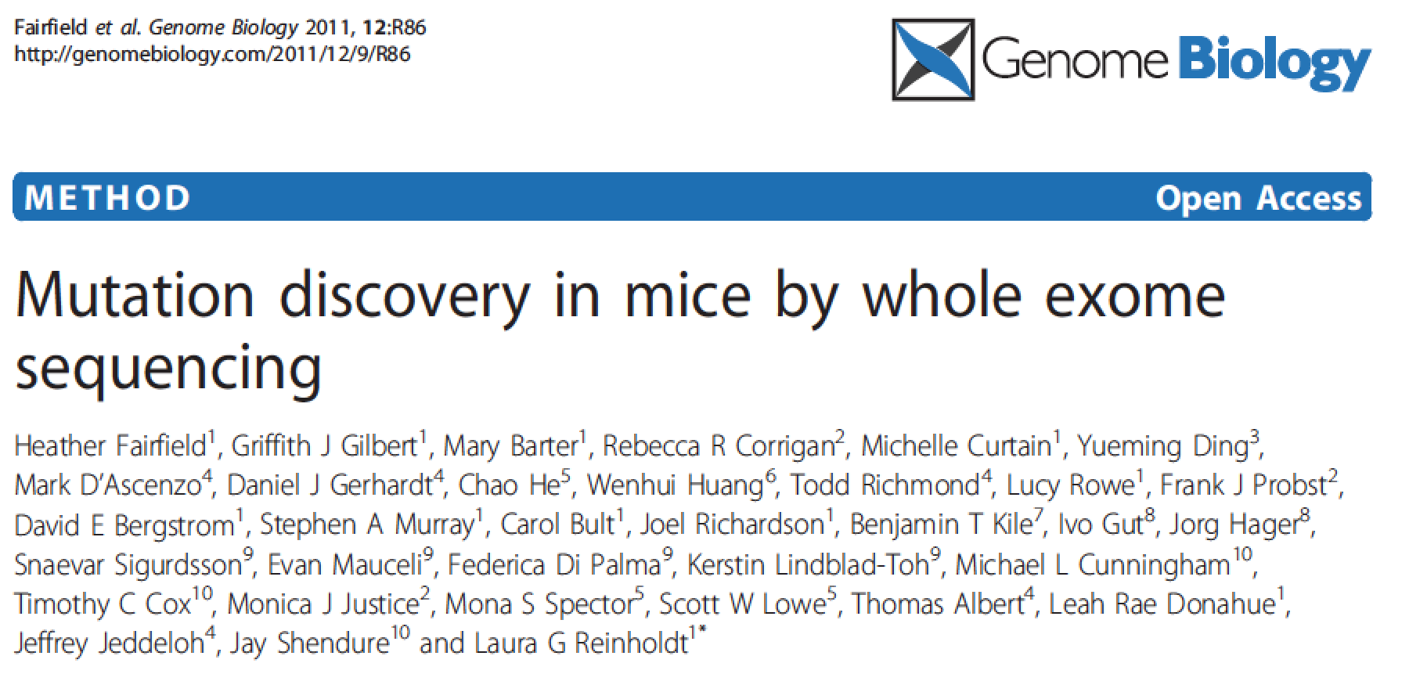
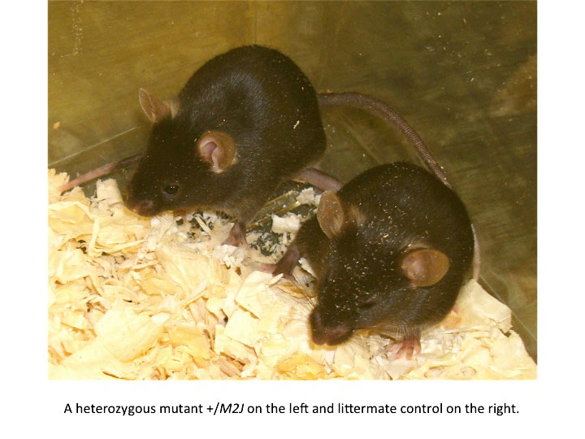
Example data for exome analysis from Fairfield et al., 2011
Focus on the Cleft mutant

Slide 9
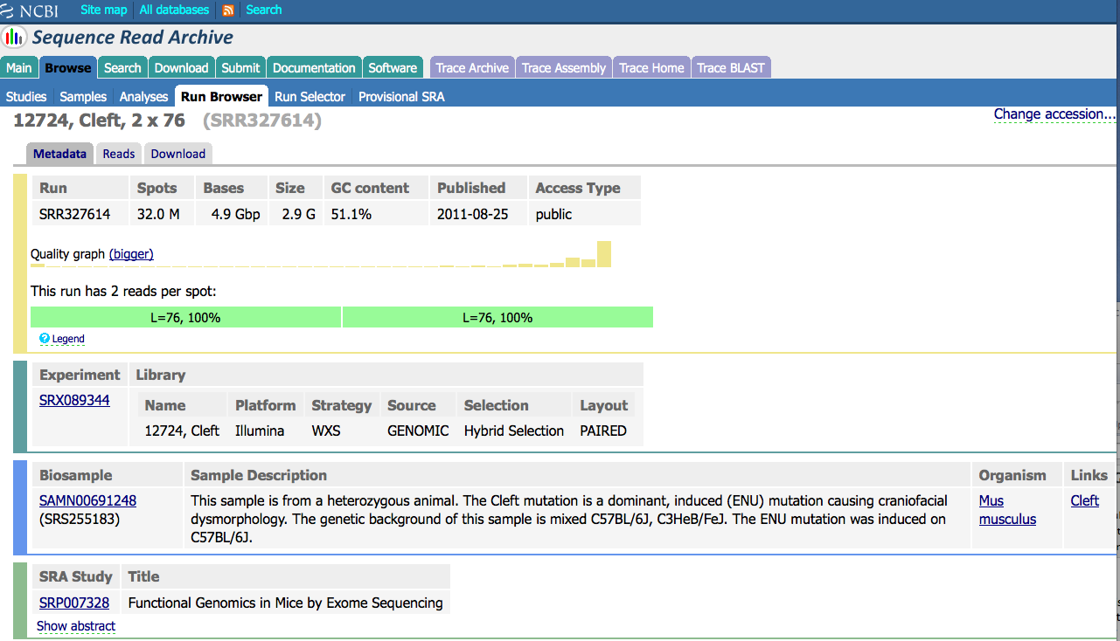
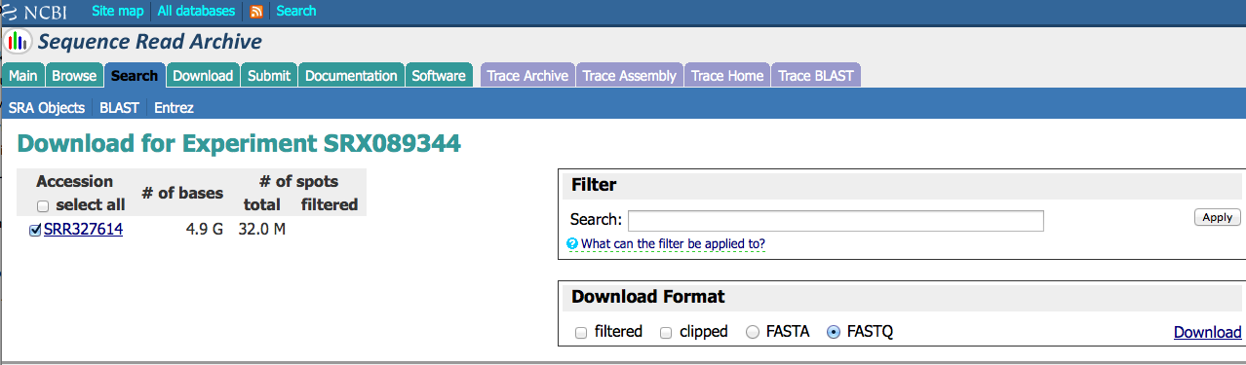
The exome data for the Cleft mutant are in the NCBI SRA and can be downloaded directly from there.
Data you download from SRA should already be in Sanger fastq format
http://trace.ncbi.nlm.nih.gov/Traces/sra/?view=search_seq_name&exp=SRX089344&run=&m=search&s=seq

Slide 10

A Simple Exome Analysis Workflow in Galaxy
Get Data into Galaxy
Get Data-> (we’ll get this from the short read archive @ NCBI)
Split merged paired end sequence data file into forward and reverse (if necessary)
NGS: QC and manipulation -> Fastq splitter
Run QC analysis
NGS: QC and manipulation -> Fastqc: Fastq QC
Map sequence reads to reference genome
NGS: Mapping -> Map with BWA for Illumina
Select appropriate parameters
Convert SAM to BAM
NGS: SAM Tools -> SAM-to-BAM
Visualize Alignments
Select UCSC genome browser or Trackster in Galaxy OR…
Download BAM and BAM index files AND
Download and Install IGV from Broad
Upload a Reference Genome (if one isn’t already in Galaxy)
Get Data -> (Mouse_GRCm38p1.fasta)
Call Variants
NGS: Variant Detection -> FreeBaye
Annotate Variants
Download VCF file
Upload to Variant Effect Predictor (VEP) @ ENSEMBL
This workflow will take some time to run!!

Slide 11
The out for one process in Galaxy becomes the input for another analysis tool.
Uploaded Cleft data from the SRA
Split the paired end reads into separate files
Mapped the reads to the mouse genome using BWA
Converted the SAM file from BWA to BAM
Extracted the subset of alignments to chromosome 15 from the whole genome BAM file

Slide 12

A Even Simpler Exome Analysis Workflow
Get Data
Get Data -> (BAM file for chromosome 15 )
Get Data
Get Data -> (mouse assembly in fasta format )
Run FreeBayes
NGS: Variant Analysis -> FreeBayes
For more information on FreeBayes: http://clavius.bc.edu/~erik/CSHL-advanced-sequencing/freebayes-tutorial.html
Download FreeBayes output (VCF file) from Galaxy
Submit VCF file to Variant Effect Predictor web site
http://useast.ensembl.org/info/docs/tools/vep/index.html

Slide 13
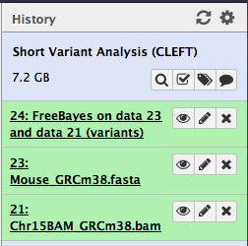
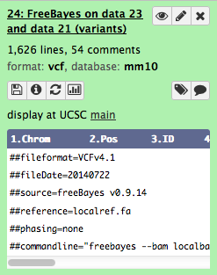
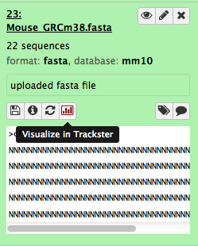
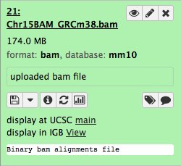
FreeBayes will use your alignments in BAM format to look for variants.

Slide 14
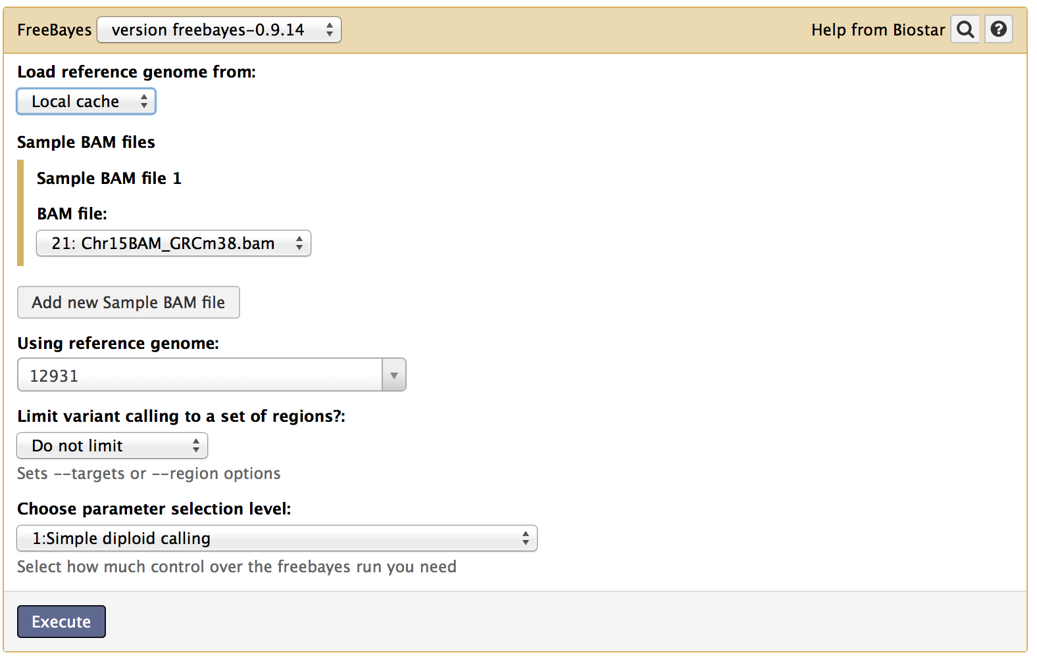
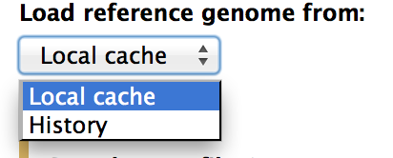
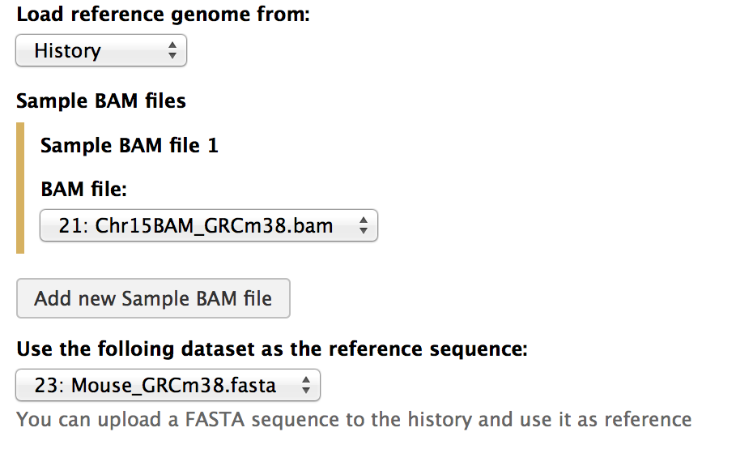
1
2
FreeBayes dialog box in Galaxy (1).
Chances are the mouse genome won’t be available. So upload your own reference from your history
Select History (2)
See the result (3)
Note that Galaxy autodetected the BAM file in your history!
3

Slide 15
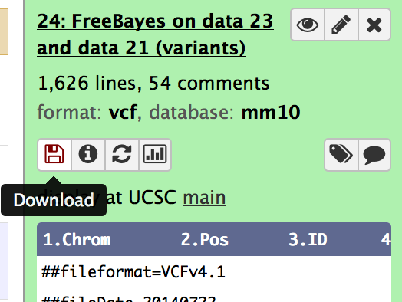
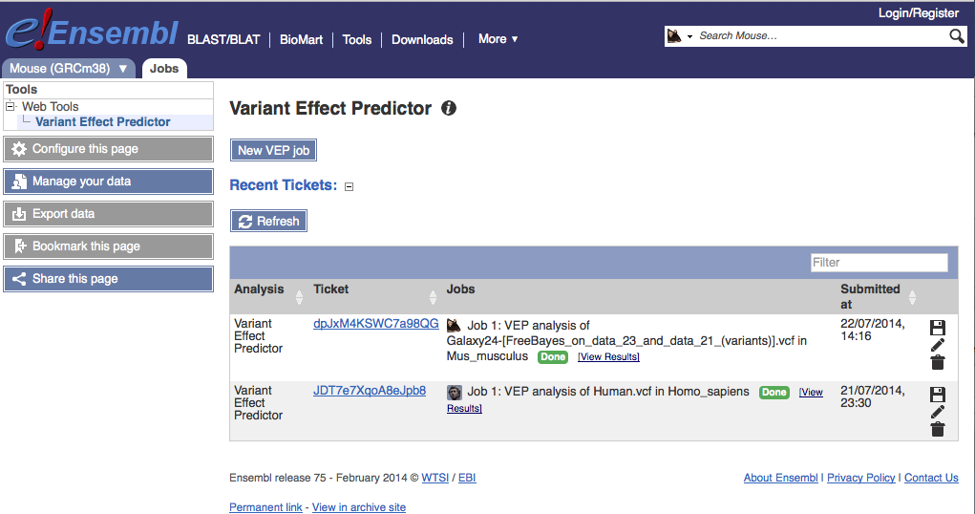
Once you have a VCF file you want to know about the nature of the variants, right?
There are some tools in Galaxy that can help with this…but VEP @ Ensembl is a great tool.
http://useast.ensembl.org/info/docs/tools/vep/index.html

Slide 16

There is a VCF file already “done” on the DropBox site that you can try with VEP.
mChr15_Cleft.vcf

Slide 17
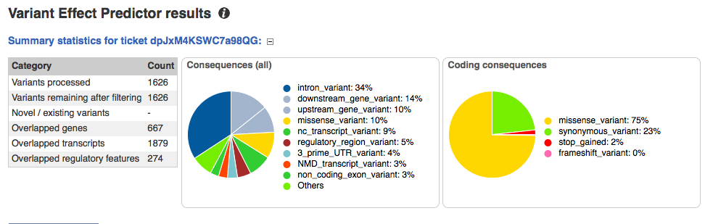
Here is a summary of the results of VEP for our Chromosome 15 data from mouse

Slide 18
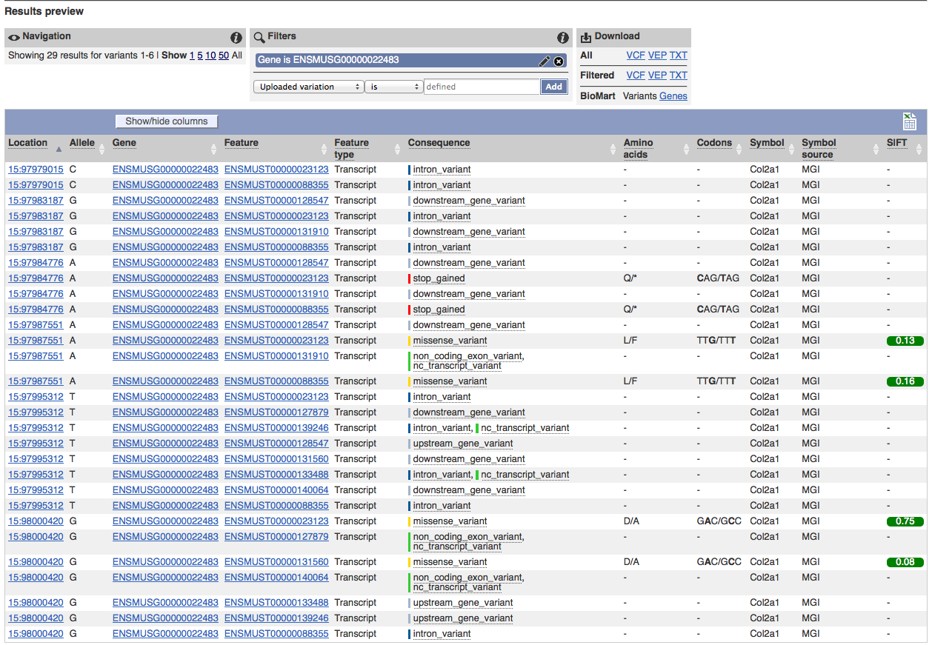
Here is the detailed annotation for the variant calls.
VEP lets you filter this by a number of parameters, including the predicted consequence of the detected variants.

Slide 19
So…which might be the causative mutation?
Not a push button answer….
Cleft is a dominant craniofacial ENU mutation that causes cleft palate. Of the two variants that were nominated for validation, both were SNVs residing in Col2a1, a gene coding for type II procollagen. Both SNVs reside within 10 kb of each other (Chr15:97815207 and Chr15:97825743) in Col2a1, a gene coding for type II procollagen, and not surprisingly were found to be concordant with the phenotype when multiple animals from the pedigree were genotyped. The most likely causative lesion (G to A at Chr15:97815207) is a nonsense mutation that introduces a premature stop codon at amino acid 645. The second closely linked variant is an A to T transversion in intron 12 that could potentially act as a cryptic splice site. However, since RTPCR did not reveal splicing abnormalities, it is more likely that the nonsense mutation is the causative lesion (Figure 2b). Mice homozygous for targeted deletions in Col2a1 and mice homozygous for a previously characterized, spontaneous mis-sense mutation, Col2a1sedc, share similar defects in cartilage development to Cleft mutants, including recessive peri-natal lethality and orofacial clefting [19,20], providing further support that the Cleft phenotype is the result of a mutation in Col2a1.
The location of the variants in this paper refer to NCBIm37…but I mapped the reads to GRCm38.p1.
How do you map Build 37 coordinates to Build 38?

Slide 20
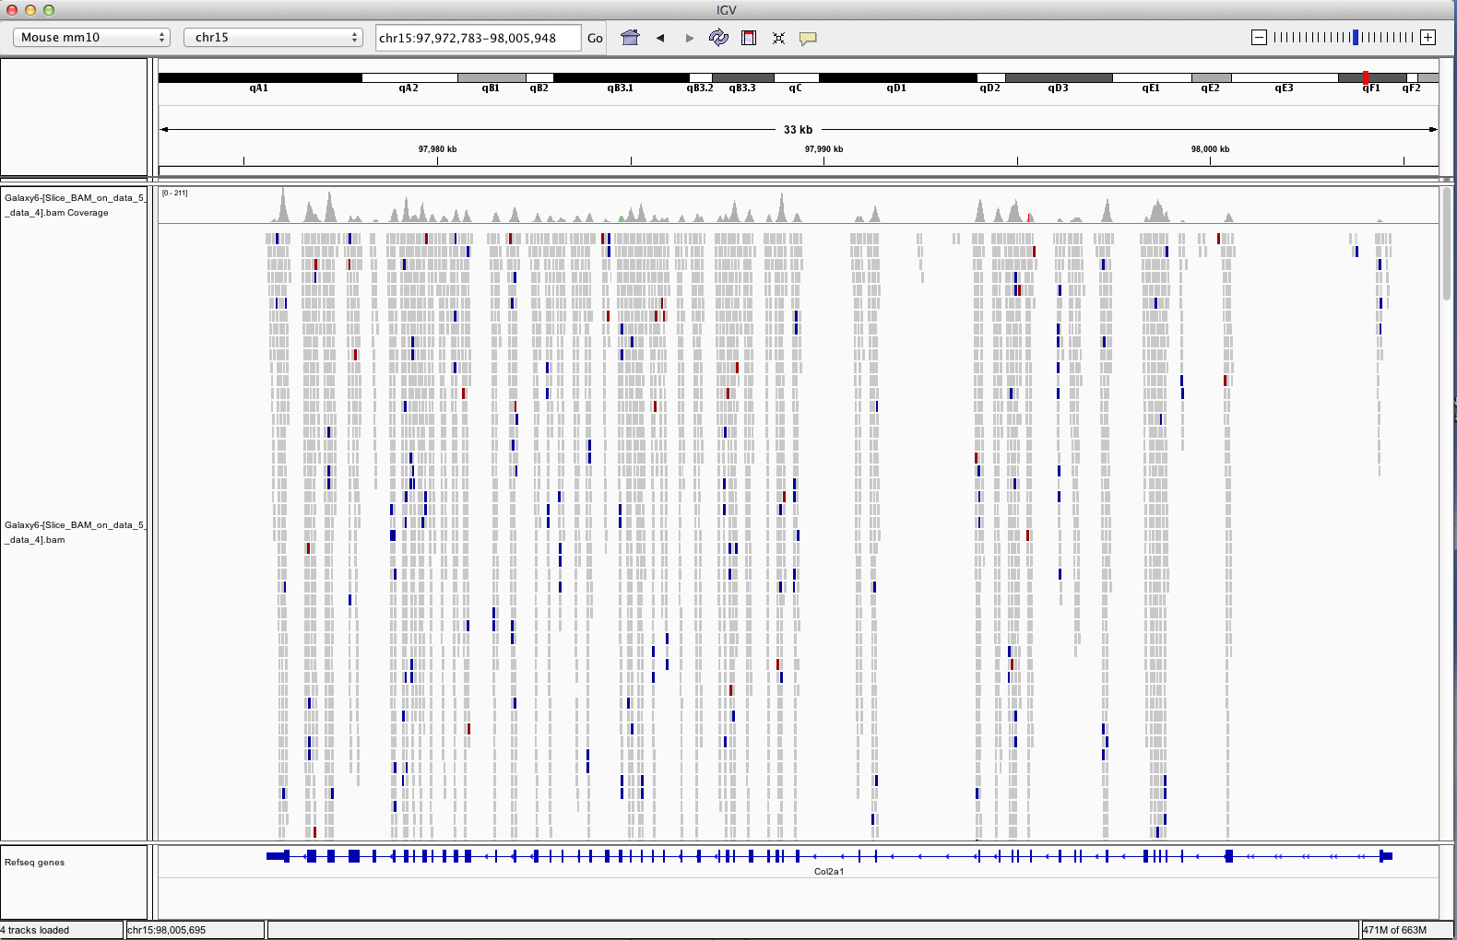
Display of sequence read alignments in the Col2a1 gene region..generated by viewing the BAM data in IGV
- need both the BAM file AND the BAM index file to display in IGV.
http://www.broadinstitute.org/igv/home

Slide 21
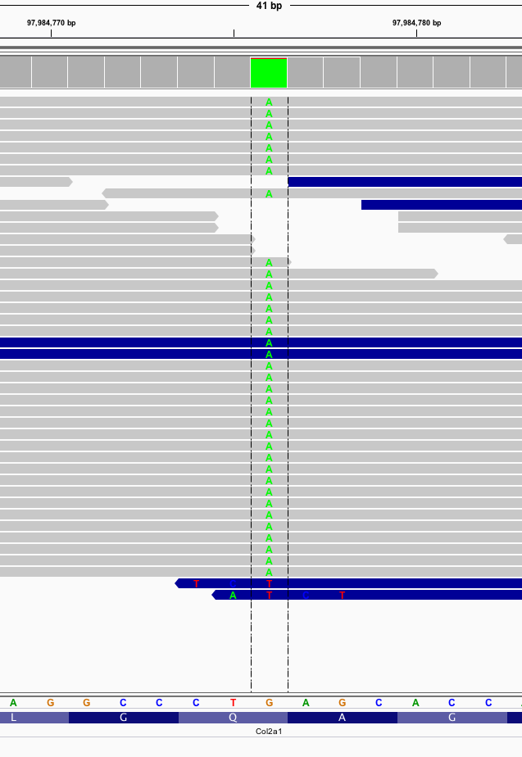
Zoomed in view using IGV for
chr15:97984776

Slide 22
Your Turn
We’ve supplied data files to let you do the longer or shorter exome workflow.
Start with the simple workflow (Chr15BAM + GRCm38.p1 -> FreeBayes).
Note…the BAM file for the entire exome data set (not just chr 15) for the Cleft mutant is also available
MMR_12724_GES_JAX_Lmerged_aln.bam

Slide 23
A Simple RNA Seq Workflow
Get sequence data
Align sequence data to a reference
TopHat is commonly used because it is tuned to aligning transcripts to a genome (splice site aware)
http://ccb.jhu.edu/software/tophat/index.shtml
Associate aligned reads to transcript models/annotations
Cufflinks
Quantitation of expression/Differential gene expression
Cuffmerge/Cuffdiff
http://cufflinks.cbcb.umd.edu/tutorial.html

Slide 24
Typical RNA_Seq Project Work Flow
Tissue Sample
Total RNA
mRNA
cDNA
FASTQ file
Sequencing
QC
TopHat
Cufflinks
Gene/Transcript/Exon Expression
Visualization
Statistical Analysis
JAX Computational Sciences Service

Slide 25
RNASeq Tasks, Tools and File Formats
Task
Tool
File Format
Quality Control
FastQC
FastQ, SangerFastQ
TopHat
Alignment
SAM/BAM
IGV
Summarization
Cufflinks
GTF, BED, GFF
Differential Gene Expression
Edge, DESeq, baySeq

Slide 26
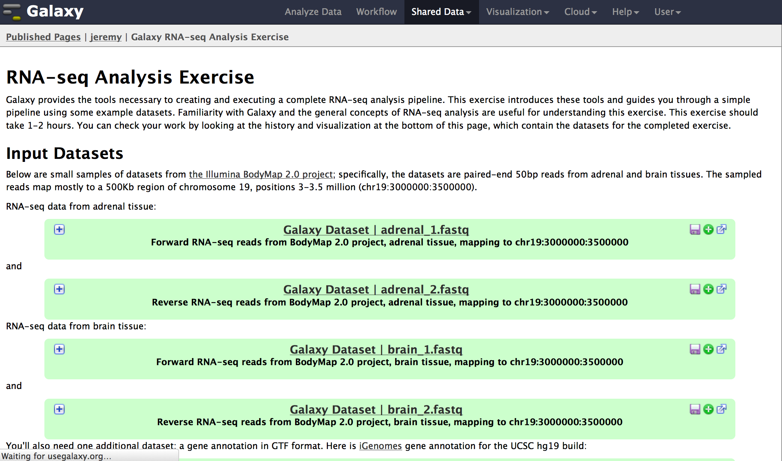
There is a nice worked example of RNA seq in the Published Pages Section of Galaxy….
To see all Published Pages, click on Shared Data -> Published Pages
https://usegalaxy.org/u/jeremy/p/galaxy-rna-seq-analysis-exercise

Slide 27
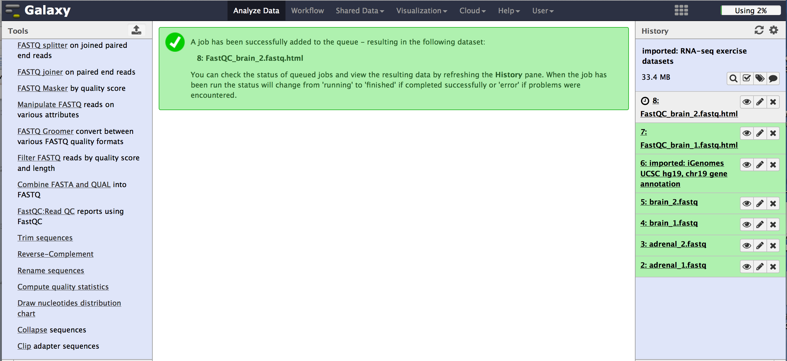
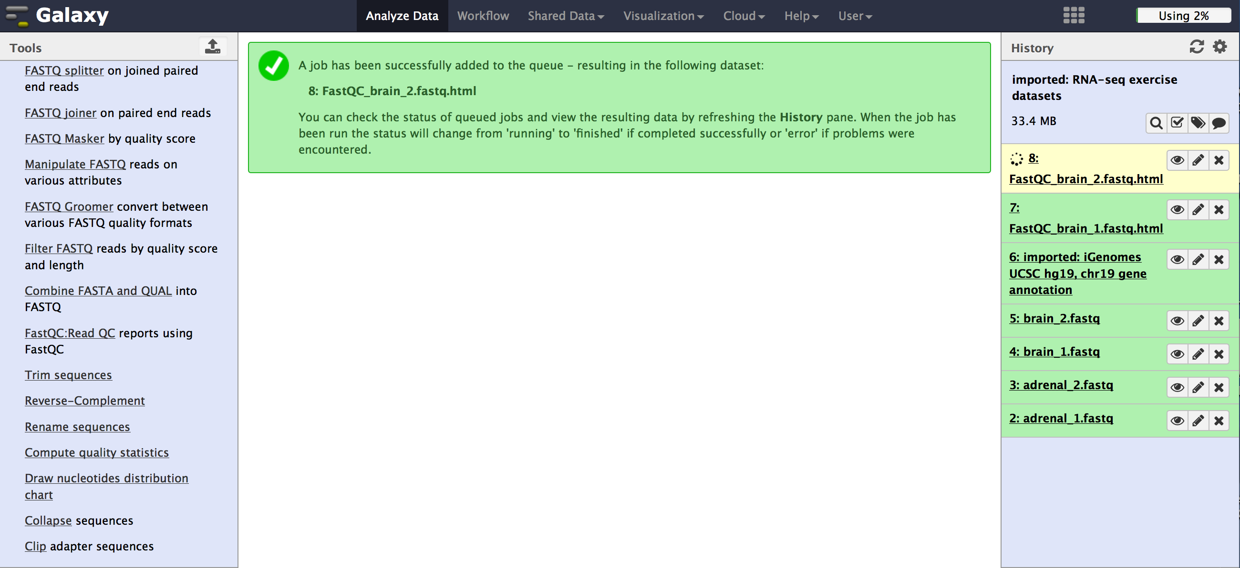
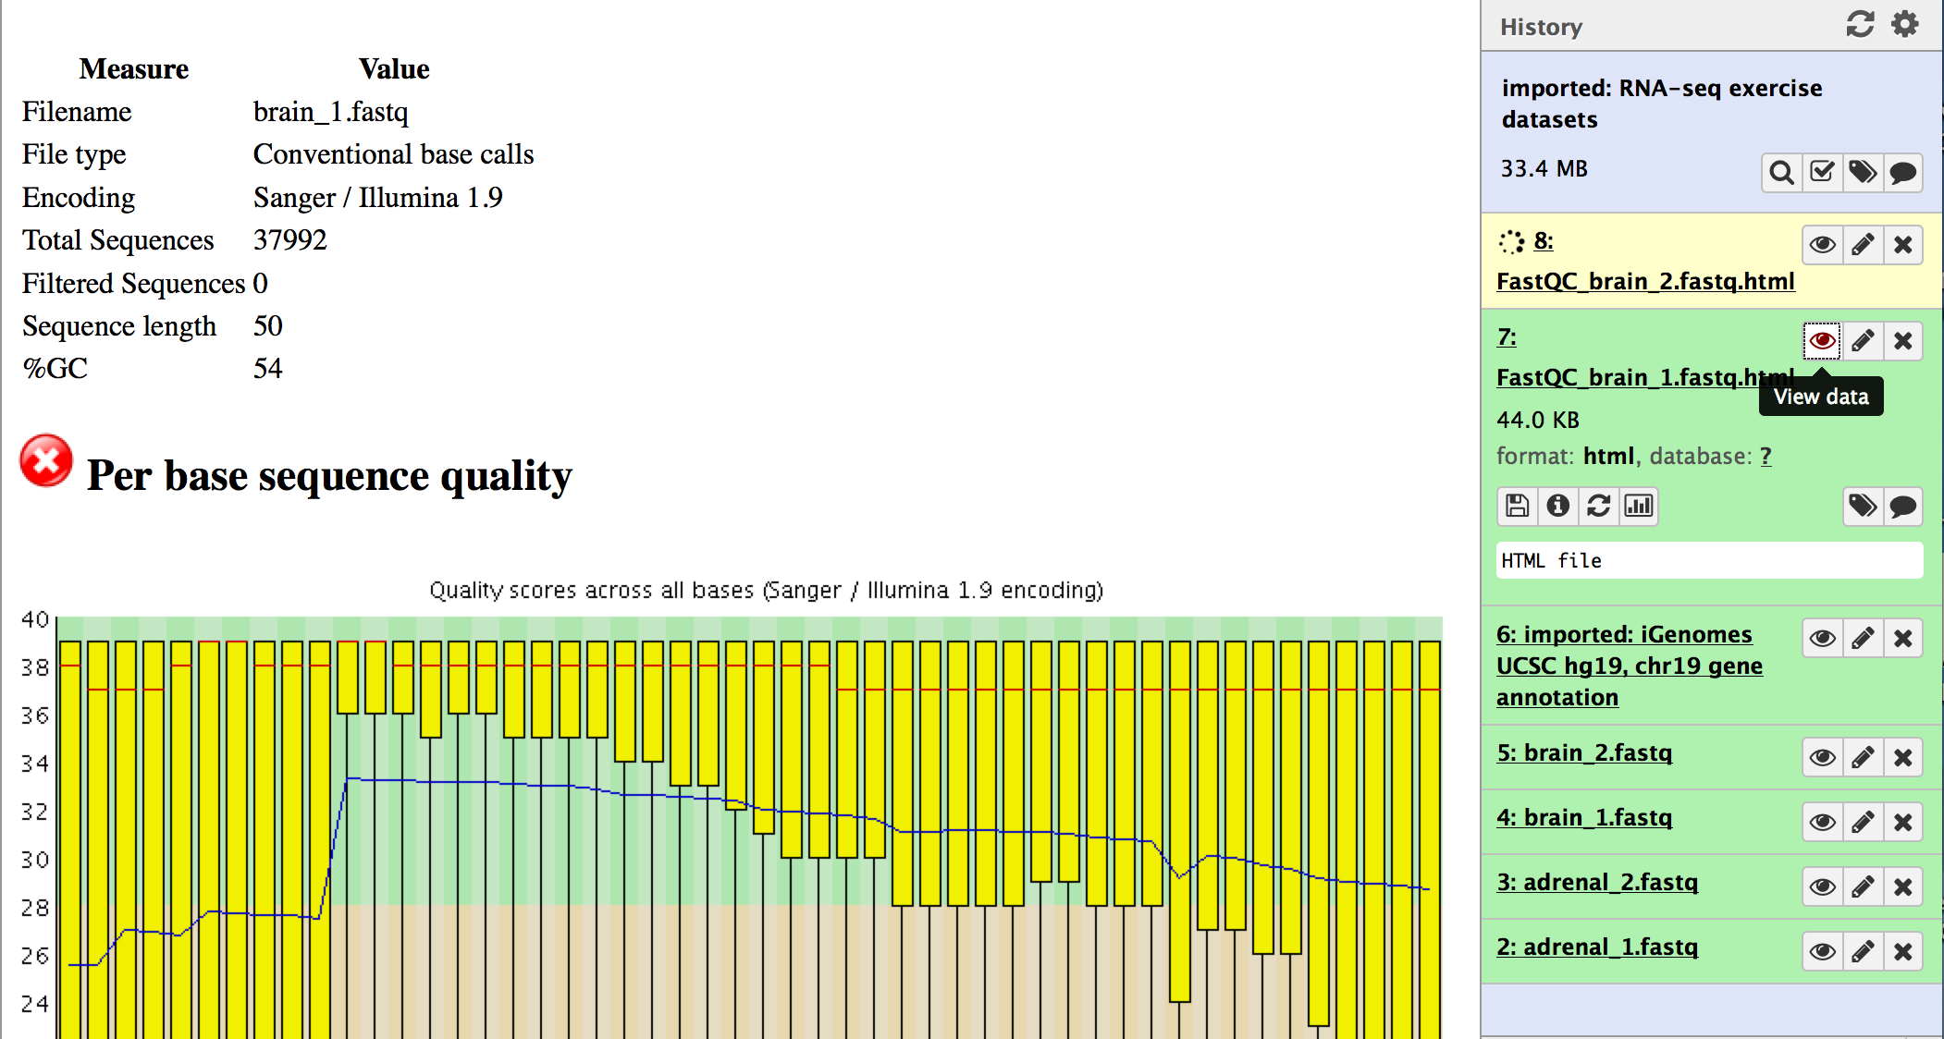
Some screenshots from the RNA Seq tutorial

Slide 28
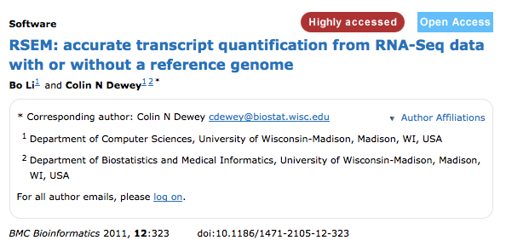

The TopHat/Cufflinks RNA Seq tools are commonly used..but they aren’t the only ones out there.
It is possible to add new tools to Galaxy via the Galaxy ToolShed but this requires some programming experience.

Slide 29
Additional Notes on Galaxy
You can try different parameters for alignment or variant calling and visualize the differences in the results
Your history helps you “remember” the parameter settings when you publish your data

Slide 30
Many Galaxy Tutorials Available
User support
https://biostar.usegalaxy.org/
Tutorials
https://usegalaxy.org/u/aun1/p/galaxy101
https://wiki.galaxyproject.org/Learn

